Slide 1
7-Day Home Workout Plan By Fitness App

Slide 2
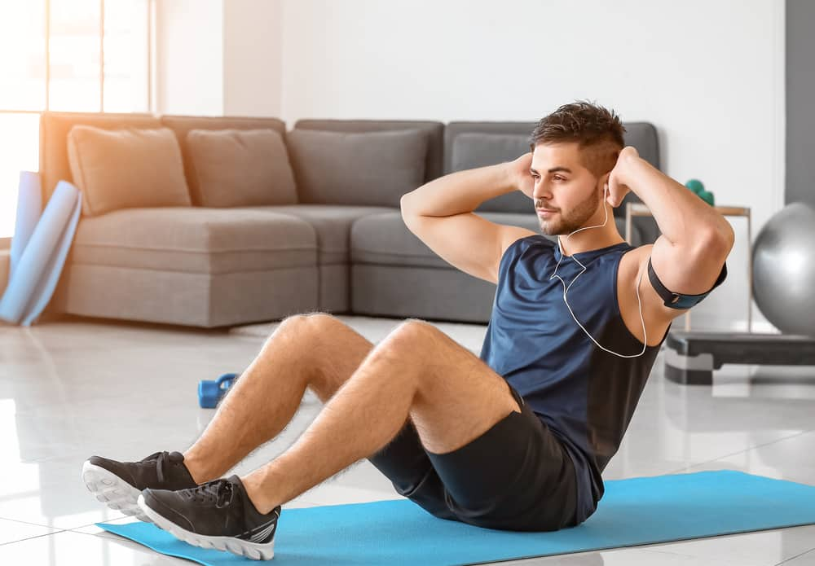
Introduction
Workout means a practice or exercise to test or improve one’s fitness. Multiple exercise make up a workout. A workout typically contains a series of exercise such as pushups, pullups, squats, lunges etc. Now a days many software based apps are available for working out at home.

Slide 3
Overview of App
The fitness app is a software based app created using flutter framework. Flutter is an open-source software development kit which enables smooth and easy cross-platform mobile app development. We can build high quality natively compiled apps for iOS and Android quickly, without having to write the code for the two apps separately.
By this app we created a 7-Day Home Workout Plan with various type of exercise.

Slide 4
Why should we use this app?
No equipment required
Cost-effective
Maintain fitness from home
Save your time

Slide 5
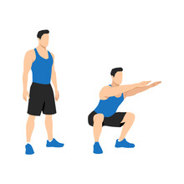
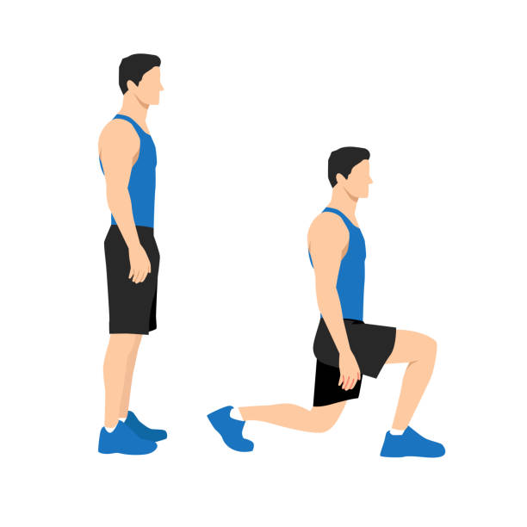
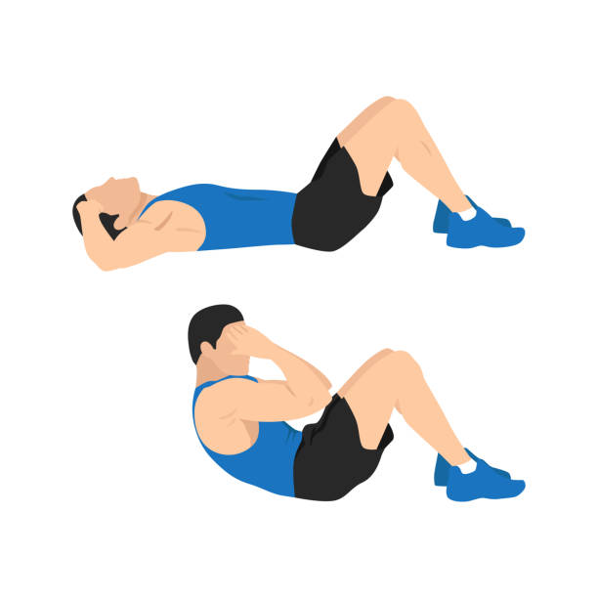
Day 1: Lower Body
Exercise 1: Squats
Exercise 2: Side-Lunges
Exercise 3: Sit-ups

Slide 6
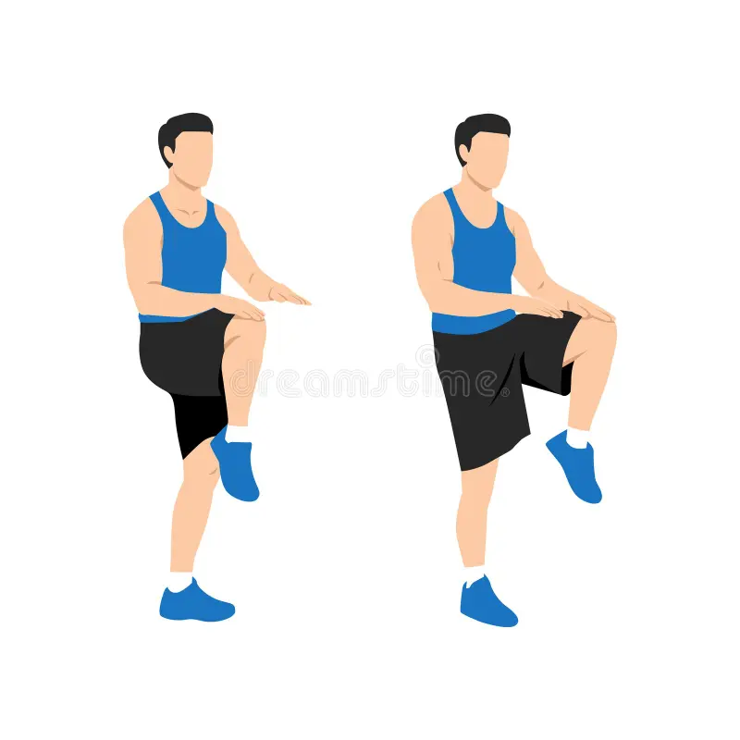
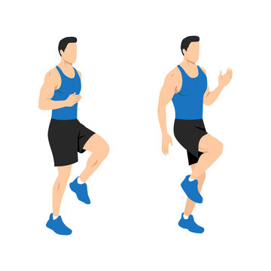
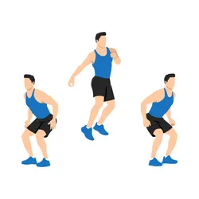
Day 2 : Cardio
Exercise 1:Front-Knees
Exercise 2: High-Knees
Exercise 3: Jump-Squat

Slide 7
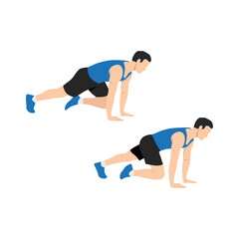
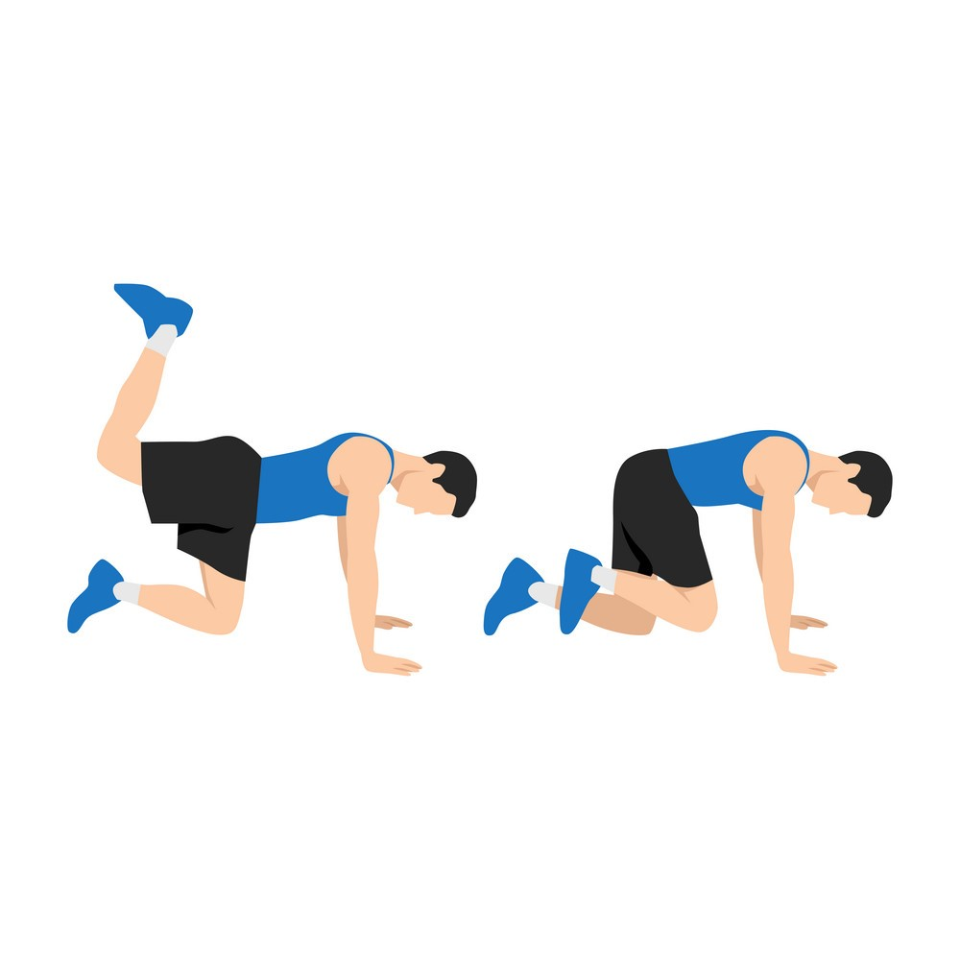
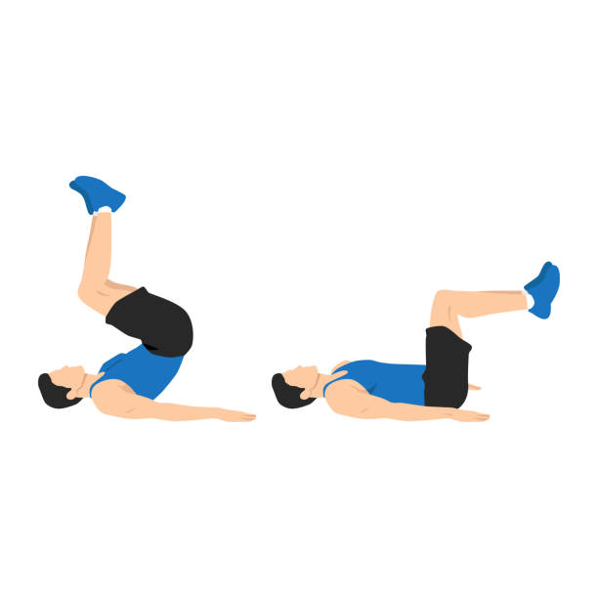
Day 3 : Core and Lower Body
Exercise 1: Climbers
Exercise 2: Donkey-Kick
Exercise 3: Crunches

Slide 8
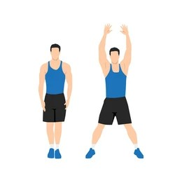
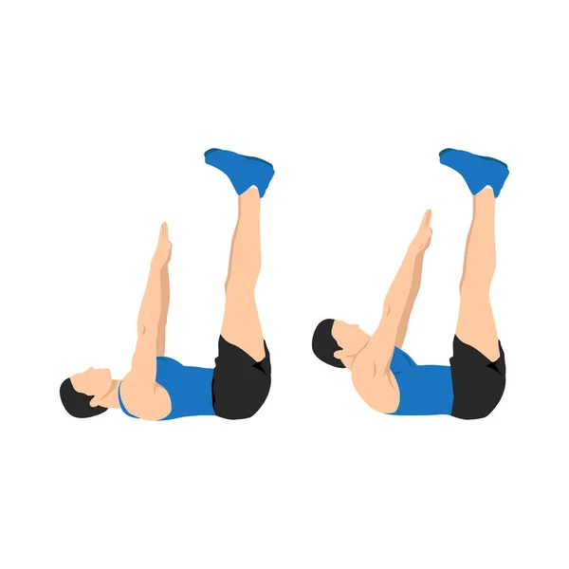
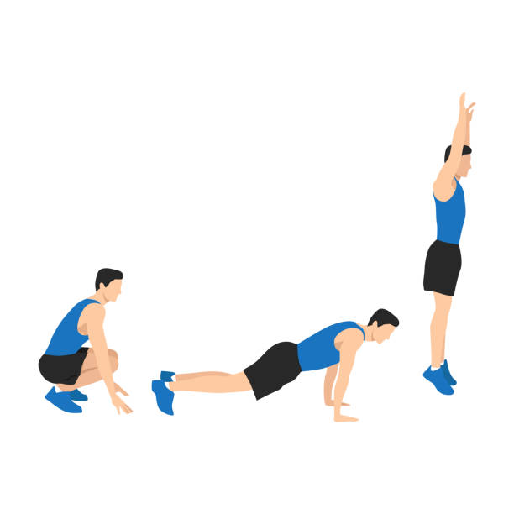
Day 4: Full Body
Exercise 1:Jumping-Jack
Exercise 2:Legs-Raise
Exercise 3:Lunge-Split-Jump

Slide 9
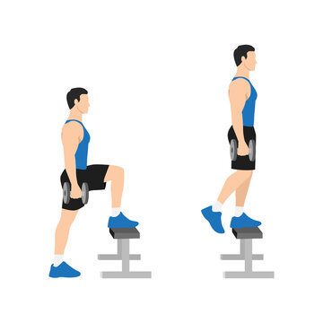
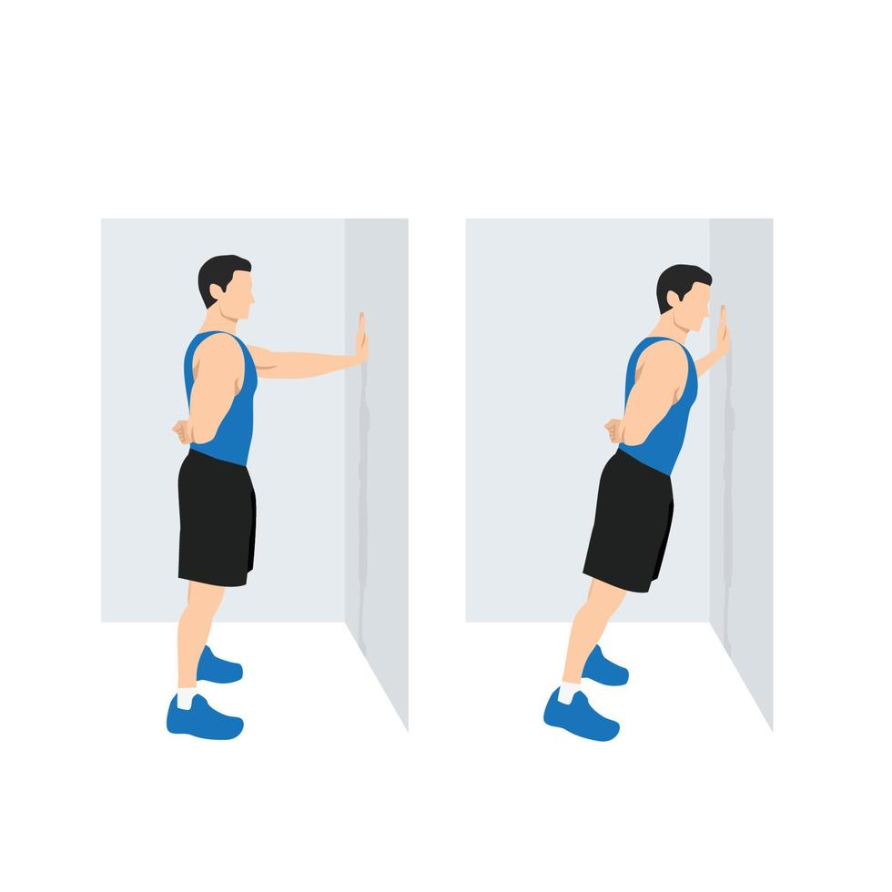
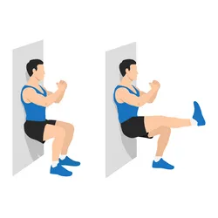
Day 5: Lower Body and Upper Body
Exercise 1: Step-Ups
Exercise 2: Wall-Push-Up
Exercise 3: Wall-Sit

Slide 10
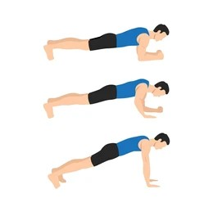
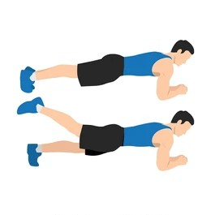
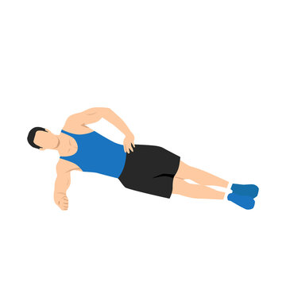
Day 6: Core
Exercise 1: Planks
Exercise 2: Plank-Right
Exercise 3: Plank-Left

Slide 11
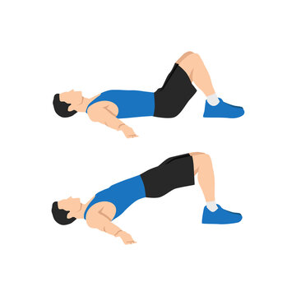
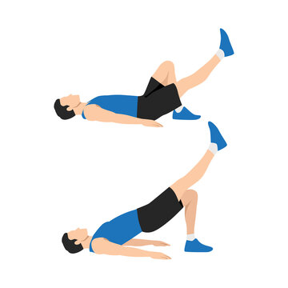
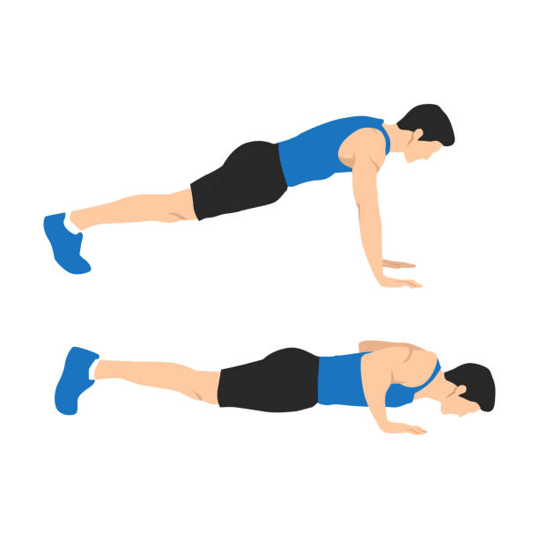
Day 7: Full Body
Exercise 1: Bridge
Exercise 2: Glute-Bridge
Exercise 3: Pushups

Slide 12
Safety Tips
Warm-up before each workout
Maintain proper form
Listen to your body
Stay hydrated

Slide 13
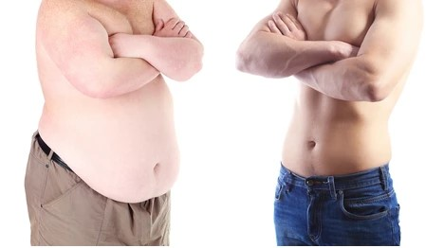
Before
After

Slide 14
Future Works
I’ll add Authentication Form
I’ll add firebase
I’ll add more types of exercises
I’ll add a proper diet
I’ll add a monthly session

Slide 15
Conclusion
Fitness app is so useful for us. By this app we can make our body fit and healthy without any cost. We can use this as our need.

Slide 16


Slide 17
Thank You

